Slide 1
INTELLIGENT AGENTS
chapter 2

Slide 2
Agents and Environments
An agent is anything that can be viewed as perceiving its environment through sensors and acting upon that environment through actuators.
A robotic agent might have cameras and infrared range ﬁnders for sensors and various motors for actuators.
A software agent receives keystrokes, ﬁle contents, and network packets as sensory inputs and acts on the environment by displaying on the screen, writing ﬁles, and sending network packets.
We use the term percept to refer to the agent’s perceptual inputs at any given instant.

Slide 3
Intelligent Agents
Have sensors, actuators
Implement mapping from percept sequence to actions
percepts
Environment
Agent
actions
Performance Measure
© Daniel S. Weld

Slide 4
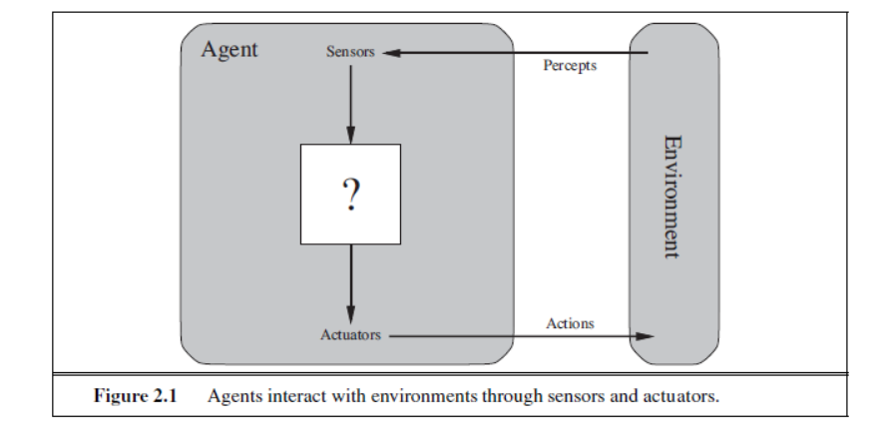

Slide 5
An agent’s percept sequence is the complete history of everything the agent has perceived.
An agent’s action at any given instant can depend on the entire percept sequence observed to date, but not on anything it hasn’t perceived
Mathematically speaking, An agent’s behavior is described by the agent function that maps any given percept sequence to an action.

Slide 6
Agent Function
we can tabulate the agent function that describes any given agent. This would be a very large table-infinite, unless we place a bound on the length of percept sequences.
Given an agent, we can construct this table by trying out all possible percept sequences and recording which actions the agent does in response.

Slide 7
Internally, the agent function for an artificial agent will be implemented by an agent program.
EXAMPLE: The vacuum cleaner world has two locations, squares A and B. The vacuum agent perceives which square it is in and whether there is dirt in the square.
It can choose to move left, move right, suck up the dirt, or do nothing.

Slide 8
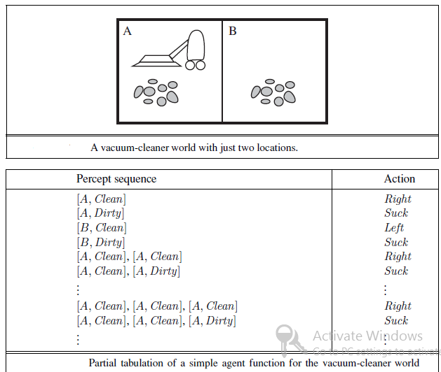

Slide 9
Good Behavior: The Concept of Rationality
A rational agent is one that does the right thing. The rationality of an agent is measured by its performance measure.
every entry in the table for the agent function is filled out correctly. doing the right thing is better than doing the wrong thing, but what does it mean to do the right thing?

Slide 10
By considering the consequences of the agent’s behavior. When an agent is plunked down in an environment,
It generates a sequence of actions according to the percepts it receives. This sequence of actions causes the environment to go through a sequence of states.
If the sequence is desirable, then the agent has performed well. This notion of desirability is captured by a performance measure

Slide 11
Rationality at any given time depends on four things
Performance measure which defines the success criterion
Agent prior knowledge of its environment.
Best possible actions that an agent can perform.
The agents percepts sequence to date

Slide 12
Rationality
DEFINITION - For each possible percept sequence, a rational agent should select an action that is expected to maximize its performance measure, given the evidence provided by the percept sequence and whatever built-in knowledge the agent has.

Slide 13
Vacuum Cleaner agent
Consider the simple vacuum-cleaner agent that cleans a square if it is dirty and moves to the other square if not; this is the agent function tabulated earlier.
The performance measure is, what is known about the environment, and what sensors and actuators the agent has. Let us assume the following:
The performance measure awards one point for each clean square at each time step, over a “lifetime” of 1000 time steps.
The “geography” of the environment is known a priori , but the dirt distribution and the initial location of the agent are not. Clean squares stay clean and sucking cleans the current square. The Left and Right actions move the agent left and right
The only available actions are Left , Right, and Suck.
The agent correctly perceives its location and whether that location contains dirt.
We claim that under these circumstances the agent is indeed rational; its expected performance is high as any other agent’s.

Slide 14
Omniscience, learning, and autonomy
An omniscient agent knows the actual outcome of its actions and can act accordingly; but omniscience is impossible in reality.
Consider example: I am walking along the Champs Elysees one day and I see an old friend across the street. There is no traffic nearby and I’m not otherwise engaged, so, being rational, I start to cross the street. Meanwhile, at 33,000 feet, a cargo door falls off a passing airliner and before I make it to the other side of the street I am flattened.
Was I irrational to cross the street?

Slide 15
This example shows that rationality is not the same as perfection.
Rationality maximizes expected performance, while perfection maximizes actual performance.
The point is that if we expect an agent to do what turns out to be the best action after the fact, it will be impossible to design an agent to fulfill this specification

Slide 16
Our definition of rationality does not require omniscience
the rational choice depends only on the percept sequence to date.
For example, if an agent does not look both ways before crossing a busy road, then its percept sequence will not tell it that there is a large truck approaching at high speed.
it would not be rational to cross the road given this uninformative percept sequence: the risk of accident from crossing without looking is too great.
Second, a rational agent should choose the “looking” action before stepping into the street, because looking helps maximize the expected performance.

Slide 17
To the extent that an agent relies on the prior knowledge of its designer rather than on its own percepts, we say that the agent lacks autonomy.
A rational agent should be autonomous—it should learn what it can to compensate for partial or incorrect prior knowledge.
For example, a vacuum-cleaning agent that learns to foresee where and when additional dirt will appear will do better than one that does not.

Slide 18
THE NATURE OF ENVIRONMENTS
Specifying The Task Environment
In the discussion of the rationality of the simple vacuum-cleaner agent,
we have to specify the performance measure, the environment, and the agent’s actuators and sensors.
We group all these under the heading of the task environment. we call this the PEAS (Performance, Environment, Actuators, Sensors) description.
In designing an agent, the first step must always be to specify the task environment as fully as possible.

Slide 19
software agents (or software robots or softbots) exist in rich, unlimited domains.
Imagine a softbot, Web site operator designed to scan Internet news sources and
show the interesting items to its users, while selling advertising space to generate revenue.
To do well, that operator will need some natural language processing abilities,
it will need to learn what each user and advertiser is interested in, and it will need to change its plans dynamically

Slide 20
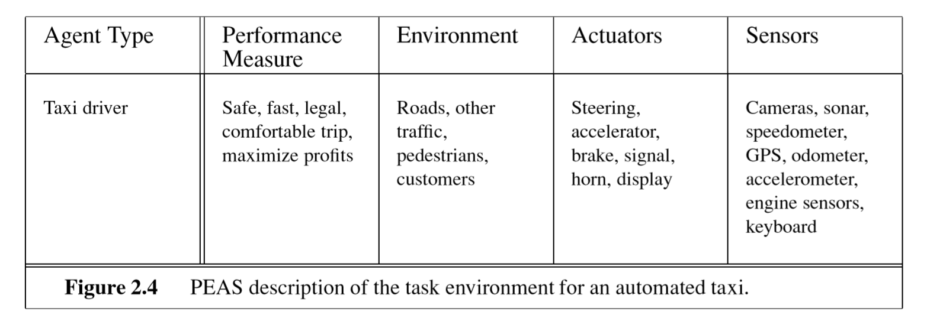
THE NATURE OF ENVIRONMENTS

Slide 21
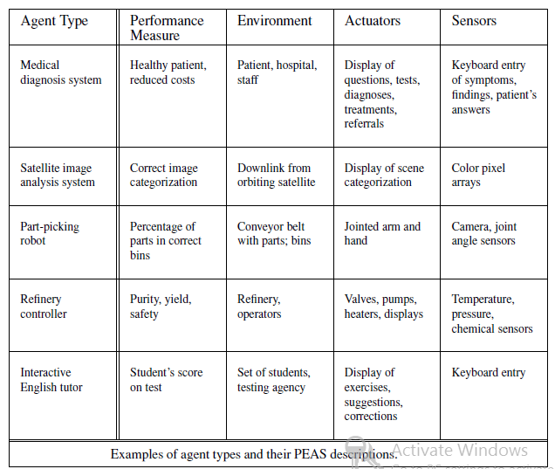

Slide 22
Properties of Task Environment
Fully observable vs. partially observable
Single agent vs. multiagent:
Deterministic vs. stochastic
Episodic vs. sequential
Static vs. dynamic
Discrete vs. continuous
Known vs. unknown

Slide 23
Types of Environment
There are different sorts of environments, which affect what an agent has to be able to cope with. In designing agents, one should always consider the pair of agent and environment together.
Fully Observable vs. Partially
Observable: If an agent's sensors give it full access to the complete state of the environment, the environment is fully observable
An environment might be partially observable because of noisy and inaccurate sensors or because parts of the state are simply missing from the sensor data
If the agent has no sensors at all then the environment is un observable.

Slide 24
Single Agent vs. Multiagent:
Entities in the environment must be modelled as agents. Are they cooperative or competitive?
an agent solving a crossword puzzle by itself is clearly in a single-agent environment,
an agent playing chess is in a two agent environment.

Slide 25
Deterministic vs. Stochastic:
If the next state of the environment is completely determined by the current state and the agent's selected action, the environment is deterministic. An environment may appear stochastic if it is only partially observable.
Taxi driving is clearly stochastic, because one can never predict the behavior of traffic exactly;
moreover, one’s tires blow out and one’s engine seizes up without warning.
The vacuum world as we described it is deterministic,
but variations can include stochastic elements such as randomly appearing dirt and an unreliable suction mechanism

Slide 26
Episodic vs. Sequential:
In an episodic task environment, the agent’s experience is divided into atomic episodes. In each episode the agent receives a percept and then performs a single action. The next episode does not depend on the actions taken in previous episodes.
For example, an agent that has to spot defective parts on an assembly line, each decision is based on the current part, regardless of previous decisions
In sequential environments, on the other hand, the current decision could affect all future decisions. Chess and taxi driving are sequential

Slide 27
Static vs. Dynamic:
If the environment can change while the agent
is deciding what to do, the environment
is dynamic for the agent otherwise it is static
If the environment itself does not change with the passage of time but the agent’s performance score does, then we say the environment is semi dynamic.
Taxi driving is dynamic: the other cars and the taxi itself keep moving while the driving algorithm dithers about what to do next.
Chess, when played with a clock, is semi dynamic.
Crossword puzzles are static.

Slide 28
Discrete vs. Continuous:
The discrete/continuous distinction applies to the state of the environment, the way time is handled, and to the percepts and actions of the agent.
For example, the chess environment has a finite number of distinct states
Taxi driving is a continuous, the speed and location of the taxi and of the other vehicles sweep through a range of continuous values .

Slide 29
Known vs. unknown
In a known environment, the outcomes for all actions are given.
if the environment is unknown, the agent will have to learn how it works in order to make good decisions.

Slide 30
The distinction between known and unknown environments is not the same as the one between fully and partially observable environments.
It is quite possible for a known environment to be partially observable—for example, in solitaire card games, I know the rules but am still unable to see the cards that have not yet been turned over.
Conversely, an unknown environment can be fully observable—in a new video game, the screen may show the entire game state but I still don’t know what the buttons do until I try them.

Slide 31
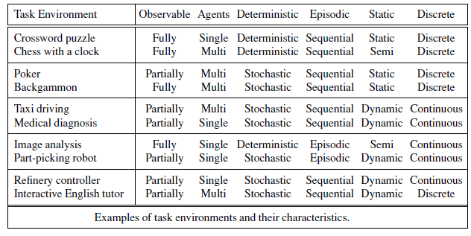

Slide 32
THE STRUCTURE OF AGENTS
So far we have talked about agents by describing behavior—the action that is performed after any given sequence of percepts.
The job of AI is to design an agent program that implements the agent function—the mapping from percepts to actions.
We assume this program will run on some sort of computing device with physical sensors and actuators—we call this the architecture:
agent = architecture + program

Slide 33
Agent programs
Agents take the current percept as input from the sensors and return an action to the actuators.
The agent program takes just the current percept as input because nothing more is available from the environment
If the agent’s actions need to depend on the entire percept sequence, the agent will have to remember the percepts.

Slide 34
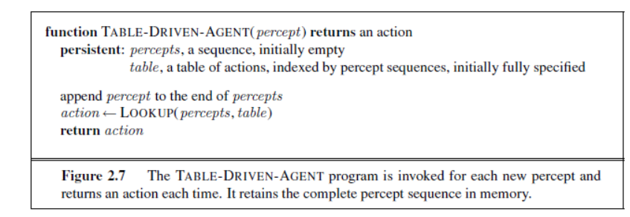

Slide 35
Figure 2.7 shows a agent program that keeps track of the percept sequence and then uses it to index into a table of actions to decide what to do.
To build a rational agent, designers must construct a table that contains the appropriate action for every possible percept sequence

Slide 36
Types of AI Agents
four basic kinds of agent programs
      Simple Reflex Agent
      Model-based reflex agent
      Goal-based agents
      Utility-based agent

Slide 37
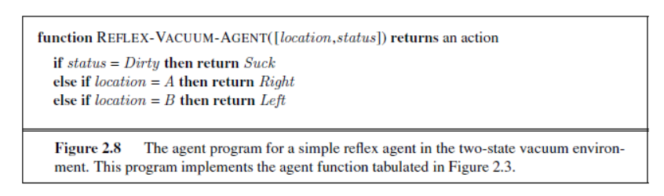
Simple Reflex agent
These agents take decisions on the basis of the current percepts and ignore the rest of the percept history.
For example, the vacuum agent is a simple reflex agent, because its decision is based only on the current location and on whether that location contains dirt.

Slide 38
Simple reflex behaviors occur even in more complex environments.
Imagine yourself as the driver of the automated taxi. If the car in front brakes and its brake lights come on,
Then you should notice this and initiate braking.
some processing is done on the visual input to establish the condition we call “The car in front is braking.”
Then, this triggers “initiate braking.”
We call such a connection a condition–action
if car-in-front-is-braking then initiate-braking.

Slide 39
Simple reflex agents
AGENT
Sensors
what world is
like now
ENVIRONMENT
what action
should I do now?
Condition/Action rules
Actuators
© Daniel S. Weld

Slide 40
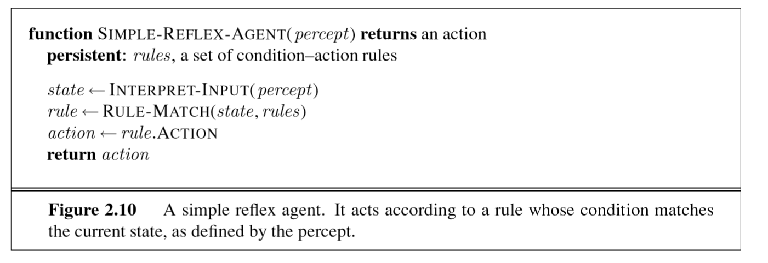

Slide 41
The INTERPRET-INPUT function generates an abstracted description of the current state from the percept,
RULE-MATCH function returns the first rule in the set of rules that matches the given state description.
Agents turn out to be of limited intelligence. The agent in Figure 2.10 will work only if the correct decision can be made on the basis of only the current percept

Slide 42
car-in-front-is-braking can be determined from the current percept in a single frame of video.
This works if the car in front has a centrally mounted brake light.
older models have different configurations of taillights, brake lights, and turn-signal lights, and
it is not always possible to tell from a single image whether the car is braking.
A simple reflex agent driving behind such a car would either brake continuously and unnecessarily, or, worse, never brake at all.

Slide 43
Model-based reflex agent
The most effective way to handle partial observability is for the agent to keep track of the part of the world it can’t see now
The agent should maintain some sort of internal state that depends on the percept history and thereby reflects at least some of the unobserved aspects of the current state.
For the braking problem, the internal state is, just the previous frame from the camera, allowing the agent to detect when two red lights at the edge of the vehicle go on or off simultaneously.

Slide 44
Updating agent internal state information requires two kinds of knowledge to be encoded in the agent program
First, we need some information about how the world evolves independently of the agent
for example, that an overtaking car generally will be closer behind than it was a moment ago.
Second, we need some information about how the agent’s actions affect the world
for example, that when the agent turns the steering wheel clockwise, the car turns to the right
This knowledge about “how the world works is called a model of the world. An agent that uses such a model is called a model-based agent.

Slide 45
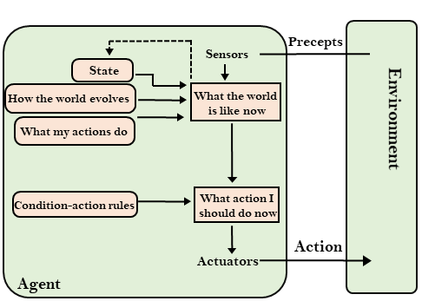
Model-based reflex agent

Slide 46
Figure shows the current percept is combined with the old internal state to generate the updated description of the current state, based on the agent’s model of how the world works.
the function UPDATE-STATE, which is responsible for creating the new internal state description

Slide 47
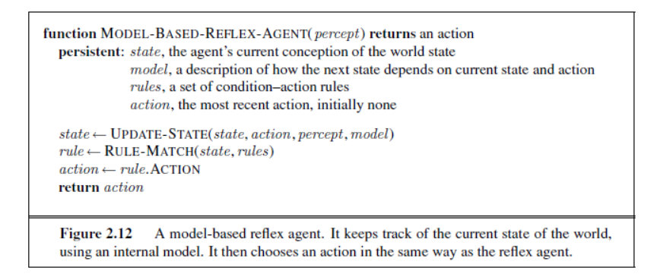

Slide 48
Goal-based agents
The knowledge of the current state environment is not always sufficient to decide for an agent to what to do.
The agent needs to know its goal which describes desirable situations.
For example, at a road junction, the taxi can turn left, turn right, or go straight on. The correct decision depends on where the taxi is trying to get to.
Goal-based agents expand the capabilities of the model-based agent by having the "goal" information.
They choose an action, so that they can achieve the goal.
These agents may have to consider a long sequence of possible actions before deciding whether the goal is achieved or not. Such considerations of different scenario are called searching and planning

Slide 49
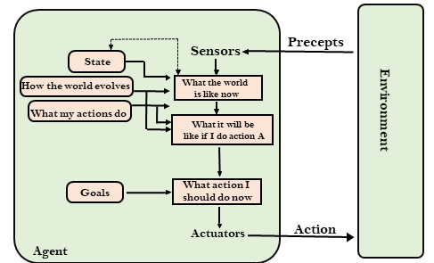
Goal-based agents

Slide 50
Utility-based agents
These agents are similar to the goal-based agent but provide an extra component of utility measurement which makes them different by providing a measure of success at a given state.
Utility-based agent act not only based on goals but also the best way to achieve the goal.
Goals alone are not enough to generate high-quality behavior in most environments.

Slide 51
For example, many action sequences will get the taxi to its destination (thereby achieving the goal) but some are quicker, safer, more reliable, or cheaper than others.
The Utility-based agent is useful when there are multiple possible alternatives, and an agent has to choose in order to perform the best action.
The utility function maps each state to a real number to check how efficiently each action achieves the goals.

Slide 52
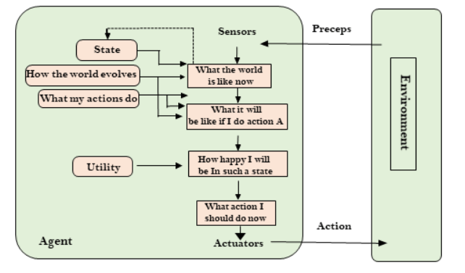
Utility-based agents

Slide 53
Learning Agents
A learning agent in AI is the type of agent which can learn from its past experiences, or it has learning capabilities.
It starts to act with basic knowledge and then able to act and adapt automatically through learning.
A learning agent has mainly four conceptual components, which are:
  Learning element: It is responsible for making improvements by learning from environment
  Performance element: It is responsible for selecting external action
  Critic: Learning element takes feedback from critic on how the agent is doing and determines how the performance element should be modified to do better in the future.
  Problem generator: This component is responsible for suggesting actions that will lead to new and informative experiences.
Hence, learning agents are able to learn, analyze performance, and look for new ways to improve the performance.

Slide 54
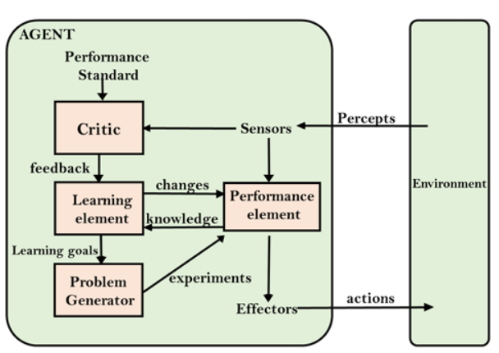
Learning Agents

Slide 55
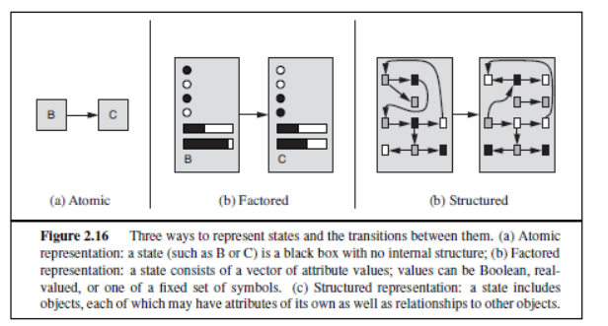
How the components of agent programs work

Slide 56
we can place the representations along an axis of increasing complexity and expressive power—atomic, factored, and structured
In an atomic representation each state of the world is indivisible—it has no internal structure
factored representation splits up each state into a fixed set of variables or attributes, each of which can have a value.
While two different atomic states have nothing in common—they are just different black boxes—
two different factored states can share some attributes (such as being at some particular GPS location) this makes it much easier to work out how to turn one state into another.

Slide 57
For many purposes, the world having things in it that are related to each other
For example, we might notice that a large truck ahead of us is reversing into the driveway of a dairy farm but a cow has got loose and is blocking the truck’s path. A factored representation is unlikely to be pre-equipped
we would need a structured representation, in which ob-jects such as cows and trucks and their various and varying relationships can be described explicitly.

